Slide 1


DHCPv6 and
IPv6 Automatic Address Allocation
Cisco Networking Academy
Rick Graziani
CS/CIS Instructor
Cabrillo College

Slide 2
Agenda
DHCPv4 – Remember IPv4?
ICMPv6 – Used more than ICMPv4
SLAACers – IPv6 Addressing without DHCPv6
Stateless DHCPv6 – I have my address but need some other stuff
Stateful DHCPv6 – Just like DHCPv4 (only different)

Slide 3

DHCPv4 – Remember IPv4?

Slide 4
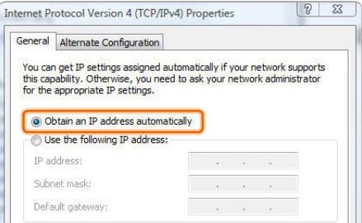
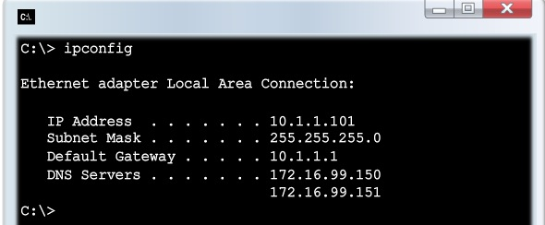
IPv4 Dynamic Addresses
DHCP Server
Client decides to use DHCPv4.

Slide 5
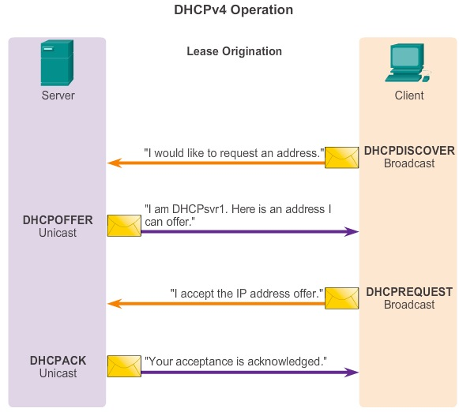

Slide 6
ICMPv6 – Used more than ICMPv4

Slide 7
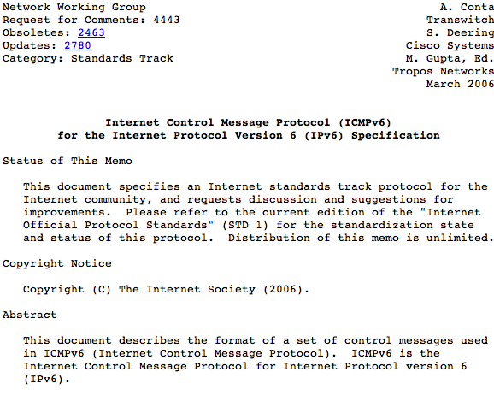
Internet Control Message Protocol (ICMPv6)
Described in RFC 4443
Much more robust than ICMP for IPv4
Contains new functionality and improvements.
More than just “messaging” but “how IPv6 conducts business”.
General message similar to ICMP for IPv4
Also uses Type and Code fields like in ICMPv4.
Two types of ICMPv6 messages
  Error messages
  Informational messages

Slide 8
Neighbor Discovery Protocol Uses ICMPv6
ICMPv6 informational messages used by Neighbor Discovery (RFC 4861):
  Router Solicitation Message
  Router Advertisement Message
  Neighbor Solicitation Message
  Neighbor Advertisement Message
  Redirect Message (Similar to ICMPv4)
Router-Device Messaging
Device-Device Messaging

Slide 9
SLAACers – IPv6 Addressing without DHCPv6

Slide 10
Configuring Dynamic IPv6 Addresses
Global Unicast
Manual
Dynamic
IPv6 Unnumbered
Stateless Autoconfiguration
IPv6 Address
DHCPv6
Static
EUI-64

Slide 11
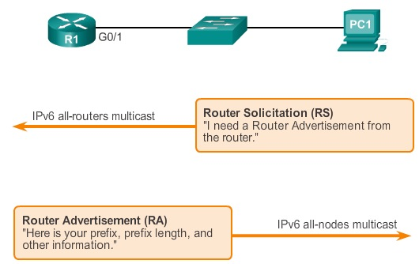
IPv6 – It all begins with the Router Advertisement
Let me tell you how we’re going to do this….
I need IPv6 addressing information….
I need IPv6 address information…
The Router Solicitation message is used to ask, “How to I I obtain an IPv6 address automatically?”

Slide 12
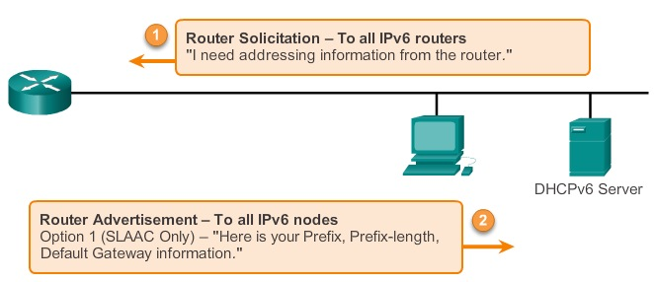
With IPv6 it begins with the Router Advertisement
The Router Advertisement (RA) tells hosts how it will receive IPv6 Address Information.
Sent periodically by an IPv6 router or…
When the router receives a Router Solicitation message from a host.

Slide 13
A Router Must Be Enabled as an “IPv6 Router”
R1(config)# ipv6 unicast-routing
DHCPv6 Server
Router Advertisement/Solicitation Messages
Part of ICMPv6 (Internet Control Message Protocol for IPv6)
Router Advertisements are sent by an “IPv6 router” – ipv6 unicast-routing command
  Forwards IPv6 Packets
  Can be enabled for IPv6 static and dynamic routing
  Sends ICMPv6 Router Advertisements
Routers can be configured with IPv6 addresses without being an IPv6 router

Slide 14
SLAAC (Stateless Address Autoconfiguration)
Option 1 and 2: Stateless Address Autconfiguration – DHCPv6 Server does not maintain state of addresses
Option 3: Stateful Address Configuration – Address received from DHCPv6 Server
DHCPv6
R1(config)# ipv6 unicast-routing
Option 1 (Default on Cisco routers) O Flag = 0, M Flag = 0
“I’m everything you need (Prefix, Prefix-length, Default Gateway)”
Option 2 (Discussed in CCNA Switching) O Flag = 1, M Flag = 0
“Here is my information but you need to get other information such as DNS addresses from a DHCPv6 server.”
Option 3 (Discussed in CCNA Switching) O Flag = x, M Flag = 1
“I can’t help you. Ask a DHCPv6 server for all your information.”
DHCPv6 Server
RA

Slide 15
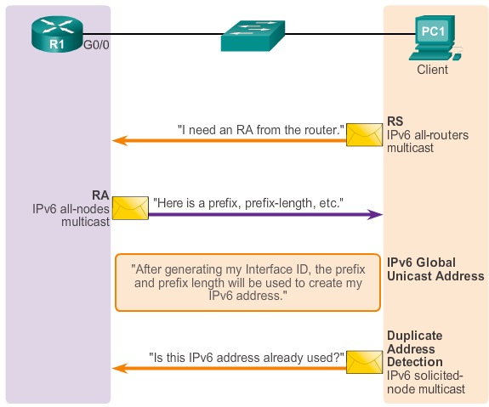
SLAAC

Slide 16
Router Advertisement – Option 1
2001:DB8:ACAD:1::/64
MAC: 00-03-6B-8C-E0-80
1
Option 1 – RA Message
To: FF02::1 (All IPv6 devices multicast)
From: FE80::1 (Link-local address)
Prefix: 2001:DB8:ACAD:1::
Prefix-length: /64
2
RA
Prefix: 2001:DB8:ACAD:1::
Prefix-length: /64
Default Gateway: FE80::1
Global Unicast Address:
2001:DB8:ACAD:1: + Interface ID
3
EUI-64 Process or Random 64-bit value
DHCPv6 Server

Slide 17


Dynamic Interface ID
Router Advertisement
2001:DB8:ACAD:1::/64
DHCPv6 Server
/48
/64
64 bits
Global Routing Prefix
Subnet ID
Interface ID
SLAAC
EUI-64 Process
Randomly Generated Number
Windows operating systems, Windows XP and Server 2003 use EUI-64.
Windows Vista and newer; hosts create a random 64-bit Interface ID.
Linux: Mostly use random 64-bit number
Mac OSX: use EUI-64 (on my Macs)

Slide 18
EUI-64 (Extended Unique Identifier – 64)
2001:DB8:ACAD:1::/64
MAC: 00-03-6B-E9-D4-80
1
Option 1 – RA Message
To: FF02::1 (All-hosts multicast)
From: FE80::1 (Link-local address)
Prefix: 2001:DB8:ACAD:1::
Prefix-length: /64
2
RA
Prefix: 2001:DB8:ACAD:1::
Prefix-length: /64
Default Gateway: FE80::1
Global Unicast Address:
2001:DB8:ACAD:1: + Interface ID
EUI-64 Process or Random 64-bit value
DHCPv6 Server

Slide 19
EUI-64
OUI
24 bits
Device Identifier
24 bits
Hexadecimal
00
03
6B
E9
D4
80
Step 1: Split the MAC address
Binary
0000 0000
0000 0011
0110 1011
1110 1001
1101 0100
1000 0000
Step 2: Insert FFFE
F F F E
Binary
0000 0000
0000 0011
0110 1011
1111 1111
1111 1110
1110 1001
1101 0100
1000 0000
Step 3: Flip the U/L bit
Binary
0000 0010
0000 0011
0110 1011
1111 1111
1111 1110
1110 1001
1101 0100
1000 0000
Modified EUI-64 Interface ID in Hexadecimal Notation
Binary
02
03
6B
FF
FE
E9
D4
80

Slide 20

PC1: Global Unicast Address
Router Advertisement
EUI-64
PC1> ipconfig
Windows IP Configuration
Ethernet adapter Local Area Connection:
Connection-specific DNS Suffix . :
IPv6 Address. . . . . . . . . . . : 2001:db8:acad:1:02-03-6b-ff-fe-e9-d4-80
Link-local IPv6 Address . . . . . : fe80::02-03-6b-ff-fe-e9-d4-80
Default Gateway . . . . . . . . . : fe80::1
Why a 64-bit interface ID?
A 64-bit Interface ID and the EUI-64 process accommodate the IEEE specification for a 64-bit MAC address.

Slide 21
Stateless DHCPv6 – I have my address but need some other stuff

Slide 22
Configuring Dynamic IPv6 Addresses
Global Unicast
Manual
Dynamic
IPv6 Unnumbered
Stateless Autoconfiguration
IPv6 Address
DHCPv6
Static
EUI-64

Slide 23
Stateless DHCPv6
Option 1 and 2: Stateless Address Autconfiguration – DHCPv6 Server does not maintain state of addresses
Option 3: Stateful Address Configuration – Address received from DHCPv6 Server
DHCPv6
R1(config)# ipv6 unicast-routing
Option 1 (Default on Cisco routers) O Flag = 0, M Flag = 0
“I’m everything you need (Prefix, Prefix-length, Default Gateway)”
Option 2 (Discussed in CCNA Switching) O Flag = 1, M Flag = 0
“Here is my information but you need to get other information such as DNS addresses from a DHCPv6 server.”
Option 3 (Discussed in CCNA Switching) O Flag = x, M Flag = 1
“I can’t help you. Ask a DHCPv6 server for all your information.”
DHCPv6 Server
RA

Slide 24
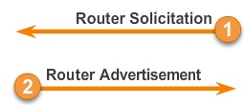
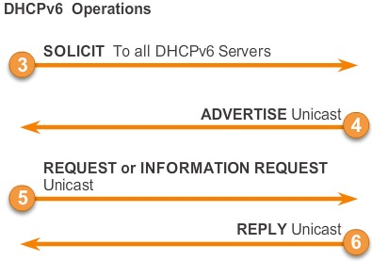
Stateless DHCPv6
I created my own address,
have a prefix-length, default gateway, but I need a DNS address…
DHCPv6
O Flag = 1, M Flag = 0
DHCPv6 Server
R1(config)# interface g0/0
R1(config-if)# ipv6 nd other-config-flag
The Router Advertisement’s Other Configuration Flag is set to “1” meaning, use me for your address but you need to get other information from a DHCPv6 server.

Slide 25
Cisco Router
Stateless DHCPv6 Server
I created my own address,
have a prefix-length, default gateway, but I need a DNS address…
DHCPv6 Server
O Flag = 1, M Flag = 0
DHCPv6
SOLICIT To all DHCPv6 Servers
3
ADVERTISE Unicast
4
REQUEST or INFORMATION REQUEST Unicast
5
REPLY Unicast
6

Slide 26
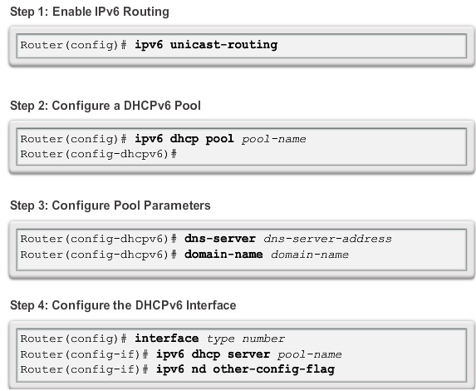
Configuring Stateless DHCPv6
Notice there isn’t a client IPv6 address

Slide 27
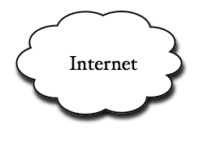

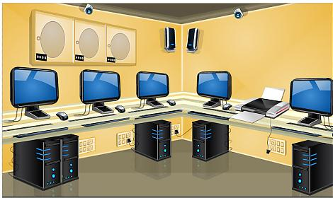
Cabrillo College 2607:F380:80F::/48
CS/CIS Department 2607:F380:80F:Fxxx::/64
xxx = VLAN/Room
G0/0
2607:F380:80F:F828::/64
DHCPv6 Server
Stateless DHCPv6
G0/01
2607:F380:80F:F830::/64
Classroom 828
Stateful
DHCPv6
Lab Room 830

Slide 28
G0/0
Router Advertisement O=1
I created my own address,
have a prefix-length, default gateway, but I need a DNS address…
S
T
A
T
E
L
E
S
S
D
H
C
P
v
6
2607:F380:80F:F828::/64
DHCPv6 Server
DHCPv6 Solicit
DHCPv6 Advertise
Router(config)# ipv6 unicast-routing
Router(config)# ipv6 dhcp pool IPV6-STATELESS
Router(config-dhcpv6)# dns-server 2607:F380:80F:F425::252
Router(config-dhcpv6)# dns-server 2607:F380:80F:F425::253
Router(config-dhcpv6)# domain-name cis.cabrillo.edu
Router(config)# interface GigabitEthernet 0/0
Router(config-if)# ip address 172.30.1.1 255.255.255.0
Router(config-if)# ipv6 address FE80::F828:1 link-local
Router(config-if)# ipv6 address 2607:F380:80F:F828::1/64
Router(config-if)# ipv6 nd other-config-flag
Router(config-if)# ipv6 dhcp server IPV6-STATELESS
Now I have a DNS address and a domain!

Slide 29
G0/0
2607:F380:80F:F828::/64
Stateless DHCPv6 Server
2607:f380:80f:f828:6909:cb1c:36a0:a595
C:\Users\Student>ipconfig /all
Windows IP Configuration
Ethernet adapter Local Area Connection:
Description . . . . . . . . . . . : Intel(R) 82566DM-2 Gigabit Network Connection
Physical Address. . . . . . . . . : 00-21-9B-88-0E-40
DHCP Enabled. . . . . . . . . . . : No
Autoconfiguration Enabled . . . . : Yes
IPv6 Address. . . . . . . . . . . : 2607:f380:80f:f828:6909:cb1c:36a0:a595
IPv4 Address. . . . . . . . . . . : 192.168.1.10(Preferred)
Subnet Mask . . . . . . . . . . . : 255.255.255.0
Default Gateway . . . . . . . . . : fe80::f828:1
DNS Servers . . . . . . . . . . . : 2607:f380:80f:f425::252
2607:f380:80f:f425::253
Connection-specific DNS Suffix Search List: cis.cabrillo.edu
Router Advertisement
Stateless DHCPv6

Slide 30
G0/0
2607:F380:80F:F828::/64
Stateless DHCPv6 Server
2607:f380:80f:f828:6909:cb1c:36a0:a595
Router# show ipv6 interface g 0/0
GigabitEthernet 0/0 is up, line protocol is up
IPv6 is enabled, link-local address is FE80::F828:1
Description: === Classroom-828 network
Global unicast address(es):
2607:F380:80F:F828::1, subnet is 2607:F380:80F:F828::/64
<Output omitted>
Hosts use stateless autoconfig for addresses.
Hosts use DHCP to obtain other configuration.
Router#

Slide 31
Stateful DHCPv6 – Just like DHCPv4 (only different)

Slide 32
Stateful DHCPv6
Option 1 and 2: Stateless Address Autconfiguration – DHCPv6 Server does not maintain state of addresses
Option 3: Stateful Address Configuration – Address received from DHCPv6 Server
DHCPv6
R1(config)# ipv6 unicast-routing
Option 1 (Default on Cisco routers) O Flag = 0, M Flag = 0
“I’m everything you need (Prefix, Prefix-length, Default Gateway)”
Option 2 (Discussed in CCNA Switching) O Flag = 1, M Flag = 0
“Here is my information but you need to get other information such as DNS addresses from a DHCPv6 server.”
Option 3 (Discussed in CCNA Switching) O Flag = x, M Flag = 1
“I can’t help you. Ask a DHCPv6 server for all your information.”
DHCPv6 Server
RA

Slide 33
Stateful DHCPv6
The router’s Router Advertisement tells me it can’t help me and I need to communicate with a stateful DHCPv6 server…
DHCPv6
O Flag = x, M Flag = 1
DHCPv6 Server
R1(config)# interface g0/1
R1(config-if)# ipv6 nd managed-config-flag
The Router Advertisement’s Managed Configuration Flag is set to “1” meaning, the client needs to get ALL of it’s information from a DHCPv6 server.

Slide 34
Cisco Router
Stateful DHCPv6 Server
The router’s Router Advertisement tells me it can’t help me and I need to communicate with a stateful DHCPv6 server…
DHCPv6 Server
O Flag= x, M Flag = 1
DHCPv6
SOLICIT To all DHCPv6 Servers
3
ADVERTISE Unicast
4
REQUEST or INFORMATION REQUEST Unicast
5
REPLY Unicast
6

Slide 35
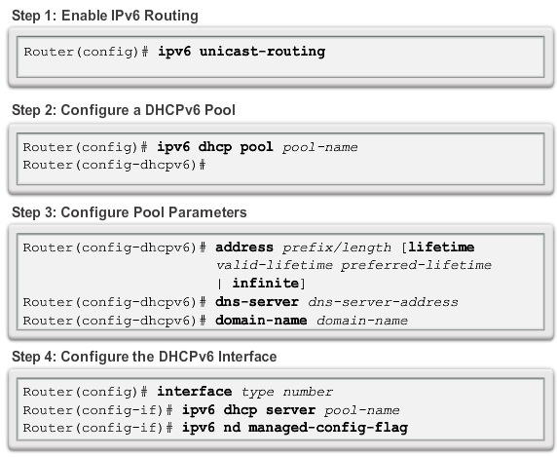

Configuring Stateful DHCPv6
?
Client IPv6 Address

Slide 36
G0/1
Router Advertisement M=1
The router’s Router Advertisement tells me it can’t help me and I need to communicate with a stateful DHCPv6 server…
S
T
A
T
E
F
U
L
D
H
C
P
v
6
2607:F380:80F:F830::/64
DHCPv6 Server
DHCPv6 Solicit
DHCPv6 Advertise
Now I have everything I need!
Router(config)# ipv6 unicast-routing
Router(config)# ipv6 dhcp pool IPV6-STATEFUL-830
Router(config-dhcpv6)# address prefix 2607:F380:80F:F830:1AB::/80 lifetime infinite infinite
Router(config-dhcpv6)# dns-server 2607:F380:80F:F425::252
Router(config-dhcpv6)# dns-server 2607:F380:80F:F425::253
Router(config-dhcpv6)# domain-name cis.cabrillo.edu
Router(config)# interface GigabitEthernet 0/1
Router(config-if)# ip address 172.20.0.1 255.255.0.0
Router(config-if)# ipv6 address FE80::F830:1 link-local
Router(config-if)# ipv6 address 2607:F380:80F:F830::1/64
Router(config-if)# ipv6 nd managed-config-flag
Router(config-if)# ipv6 dhcp server IPV6-STATEFUL-830

Slide 37
G0/1
Router Advertisement M=1
2607:F380:80F:F830::/64
DHCPv6 Server
DHCPv6 Solicit
2607:F380:80F:F830:1AB::
DHCPv6 Advertise
2607:F380:80F:F830:1AB::/80
2607:F380:80F:F830::/64
2607:F380:80F:F830:0:0:0:1
2607:F380:80F:F830:FFFF:FFFF:FFFF:FFFF
2607:F380:80F:F830:1AB::/80
2607:F380:80F:F830:1AB:0:0:1
2607:F380:80F:F830:1AB:0:0:2
2607:F380:80F:F830:1AB:0:0:3 . . .
Available addresses for this network
/64
/80
Reserved for DHCPv6 allocated addresses

Slide 38
G0/1
Router Advertisement M=1
2607:F380:80F:F830::/64
DHCPv6 Server
DHCPv6 Solicit
DHCPv6 Advertise
Router(config)# ipv6 unicast-routing
Router(config)# ipv6 dhcp pool IPV6-STATEFUL-830
Router(config-dhcpv6)# address prefix 2607:F380:80F:F830:1AB::/80 lifetime infinite infinite
/64
/80
2607:F380:80F:F830:1AB::/80
2607:F380:80F:F830:1AB:0:0:1
2607:F380:80F:F830:1AB:0:0:2
2607:F380:80F:F830:1AB:0:0:3 . . .

Slide 39
G0/1
2607:F380:80F:F828::/64
Stateful DHCPv6 Server
2607:f380:80f:f830:1ab:2de8:cfd8:5e21
C:\Users\Student>ipconfig /all
Windows IP Configuration
Ethernet adapter Local Area Connection:
Description . . . . . . . . . . . : Intel(R) 82566DM-2 Gigabit Network Connection
DHCP Enabled. . . . . . . . . . . : No
Autoconfiguration Enabled . . . . : Yes
IPv6 Address. . . . . . . . . . . : 2607:f380:80f:f830:1ab:2de8:cfd8:5e21
Lease Obtained. . . . . . . . . . : Thursday, September 26, 2013 10:17:12 AM
Lease Expires . . . . . . . . . . : Sunday, November 02, 2149 4:45:31 PM
Default Gateway . . . . . . . . . : fe80::f830:1
IPv4 Address. . . . . . . . . . . : 192.168.1.10(Preferred)
Subnet Mask . . . . . . . . . . . : 255.255.255.0
DNS Servers . . . . . . . . . . . : 2607:f380:80f:f425::252
2607:f380:80f:f425::253
Connection-specific DNS Suffix Search List : cis.cabrillo.edu
Rest of Interface ID is assigned by the router
show ipv6 dhcp binding
Router Advertisement
Stateful DHCPv6

Slide 40
G0/1
2607:F380:80F:F828::/64
Stateful DHCPv6 Server
2607:f380:80f:f830:1ab:2de8:cfd8:5e21
Router# show ipv6 interface g 0/1
GigabitEthernet 0/1 is up, line protocol is up
IPv6 is enabled, link-local address is FE80::F830:1
Description: === Lab network
Global unicast address(es):
2607:F380:80F:F830::1, subnet is 2607:F380:80F:F830::/64
<output omitted>
Hosts use DHCP to obtain routable addresses.
Router#

Slide 41
Can a host ignore the Router Advertisement?
DHCPv6 is similar to DHCPv4.
Host operating systems “may” include the option of ignoring the Router Advertisement from the router and only use the stateful services of a DHCPv6 server.
Note: All addresses should be checked before use with DAD (Duplicate Address Detection), similar to gratuitous ARP in IPv4.
DHCPv6
DHCPv6 Server

Slide 42
Summarize:
Router Solicitations and Router Advertisements
1
FF02::2
All IPv6 Routers
Router Solicitation Message
I need IPv6 address information.
PC1
DHCPv6 Server
Router Advertisement Message
Here is one of three options:
I have everything you need.
I have mostly what you need, but you will need to contact a DHCPv6 server for other information like a DNS address.
I have nothing for you. Contact a DHCPv6 serverl
2
FF02::1
All IPv6 Devices

Slide 43
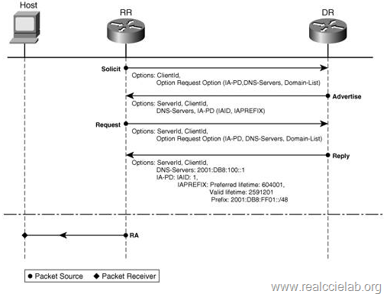
Final Note
Requesting Router
Home Router
Delegating Router
ISP Router
Most ISPs (including Comcast) have quietly turned on IPv6 to the home.
The home router uses DHCPv6 to get it’s ISP-facing IPv6 address.
The home router uses the DHCP-PD (Prefix Delegation) to ask the ISP for an IPv6 network address to give to it’s LAN clients.
The ISP router includes that in it’s DHCPv6 Advertisement.
The home router sends a Router Advertisement message to it’s LAN devices and acts just like a normal IPv6 router:
  SLAAC
  SLAAC + DHCPv6
  DHCPv6 only
I will be doing another PowerPoint for DHCP-PD

Slide 44
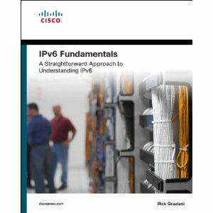
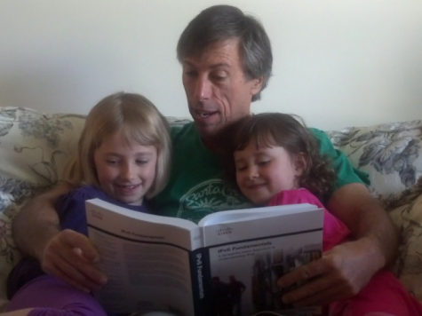
THANK YOU! ☺
Shameless plug!
Rick Graziani - graziani@cabrillo.edu
PowerPoints for CCNA, CCNP, IPv6
  www.cabrillo.edu/~rgraziani
  Username = cisco
  Password = perlman
Quality time with my two nieces…

Slide 45
DHCPv6 and
IPv6 Automatic Address Allocation
Cisco Networking Academy
Rick Graziani
CS/CIS Instructor
Cabrillo College

